Slide 1
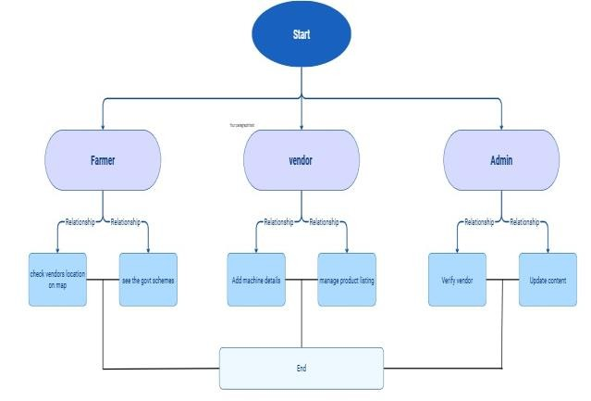
MIT SCHOOL OF COMPUTING
Class :
TY-CORE02
Group Id: 209
DEPARTMENT OF COMPUTER SCIENCE & ENGINEERING
PRO-FARMER
Modern Solution for Agriculture
ROHIT JAGTAP,YASH SONWANE,SAHIL KHANDAGLE,MITHILESH BIRADAR
Faculty Guide:
Prof.Revati Raspayle
What user (farmer) says?
What user (farmer) thinks?
Sr. No. | Requirement | Proposed Solution
1. | Easy access | Simple, mobile-friendly UI
2. | Smart decision-making | AI-based recommendations
3. | Vendor discovery | Map-based nearby vendor search
4. | Learning Support | Videos, manuals & AI chatbot
5. | Subsidy awareness | AI-based eligibility prediction
“We don’t have enough labor to work on farms.”
“We don’t know much about farming machines.”
“Even if we hear about machines, we don’t know where to buy them.”
“It’s difficult to find reliable information.”
Machines can reduce workload and save time.
Correct guidance can reduce unnecessary expenses.
A single digital platform would make decisions easier.
Government subsidies can make machines affordable.
User
What user (farmer) feels?
Frustrated because of increasing labor shortage.
Confused due to lack of clear and trustworthy machine information.
Hopeful that technology can make farming easier.
Relieved when given guidance, support, or subsidies for modern solutions.
What user (farmer) does?
Continues manual farming due to
lack of guidance.
Depends on local agents or word-of-mouth information.
Avoids modern machinery due to fear of high cost and wrong choice.
Scope
Feasibility
Technical
Build a website/app for farmers to explore machines.
Show machine details (use, cost, benefits).
Display vendor locations on maps.
Provide training videos/manuals.
Share updates on government
schemes.
Let vendors register and list machines.•
Make it mobile-friendly.
PROBLEM STATEMENT
Farmers in rural India face labor shortages, limited awareness of modern agricultural machinery, and poor access to reliable information about machine selection, pricing, vendors, and government subsidies. The absence of a unified and intelligent digital platform results in low adoption of mechanization and inefficient farming practices.
PROPOSED SOLUTION
Pro-Farmer is an AI-powered web/mobile platform that helps farmers discover, compare, and access agricultural machinery along with real-time subsidy information. The system uses Artificial Intelligence to recommend suitable machines based on crop type, land size, budget, and location, making decision-making faster, smarter, and more affordable for farmers.
Can be built with simple tools (HTML, JS, PHP/Node.js).
Database (MySQL/Firebase) for storing data.
Google Maps for vendor locations.
Easy to expand in future.
Financial
Low cost to develop and maintain.
Vendors pay small fee to list products.
Ads and partnerships for extra income.
Farmers save money by reducing labor costs.
Possible government funding/subsidy.

